Slide 1
Predictive Maintenance Use case

Slide 2
Introduction
Definition of Predictive Maintenance
Predictive maintenance is a proactive maintenance strategy that utilizes data analysis, machine learning algorithms, and sensor technologies to predict equipment failures before they occur.
By analyzing real-time and historical data, predictive maintenance aims to identify patterns and anomalies that signal potential issues, allowing maintenance teams to schedule repairs or replacements at optimal times.

Slide 3
Importance of Predictive Maintenance in Various Industries
Predictive maintenance plays a crucial role in industries such as manufacturing, energy, transportation, healthcare, and more.
In manufacturing, unplanned downtime due to equipment failure can result in significant production losses and costs. Predictive maintenance helps minimize downtime by detecting issues early.
In energy production, such as oil and gas, power plants, and renewable energy facilities, equipment failure can lead to safety hazards and environmental risks. Predictive maintenance ensures reliability and safety.
In transportation, including aviation, railways, and fleet management, predictive maintenance enhances operational efficiency, reduces maintenance costs, and improves passenger safety.
In healthcare, predictive maintenance of medical equipment ensures uninterrupted patient care and reduces the risk of medical errors.

Slide 4
Objective
The project aims to predict machine failures without knowing the specific failure mode.
The objective is to develop models that accurately predict machine failures based on these features
Air Temperature, Process Temperature, Rotational Speed, Torque, and Tool Wear.

Slide 5
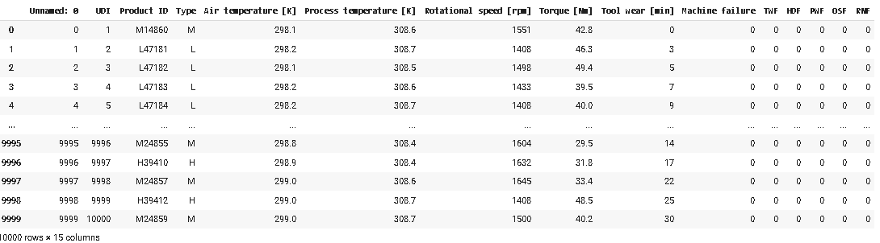
Exploratory Data Analysis
Dataset Overview
we imported a dataset that contains information about machinery parameters . Air Temperature, Process Temperature, Rotational Speed, Torque, and Tool Wear.
Our dataset compromise 10000 rows and 15 columns .

Slide 6
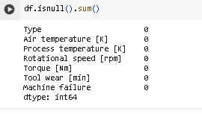
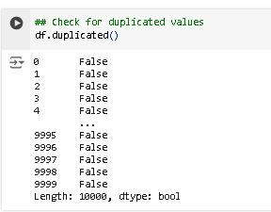
Data Exploration and Preprocessing
Dropped irrelevant columns :["Unnamed: 0","UDI", "ProductID","RNF","OSF","PWF","HDF","TWF"]
Checked for null values
-> Our data has no null values
checked for duplicate values
-> No duplicates
Data Preprocessing Notebook

Slide 7
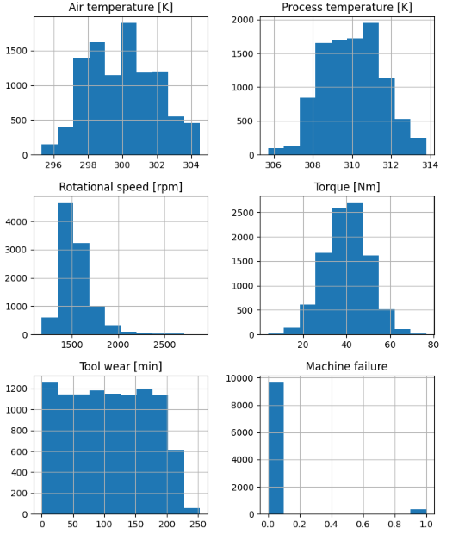
Identified Key Features :
•Air Temperature [K]
•Process Temperature [K]
•Rotational Speed [rpm]
•Torque [Nm]
•Tool Wear [min]
•Failure Labels: [1 Failure | 0 No Failure]

Slide 8
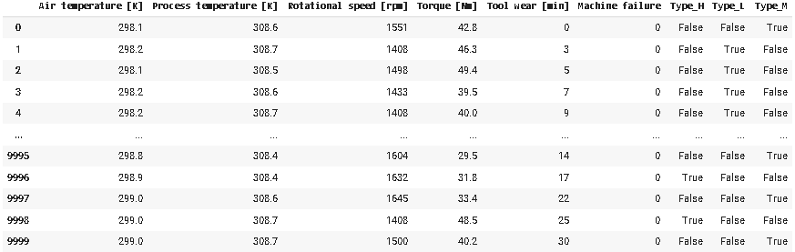
Handled Categorical Variables : one-hot encoding
transform categorical values into dummy/indicator variables.
the original 'Type' column will be replaced with new binary columns, each representing one of the unique categories in the original 'Type' column. I did This transformation as many Machine learning models require numerical input data, and encoding categorical variables in this way allows me to include them in my analysis

Slide 9
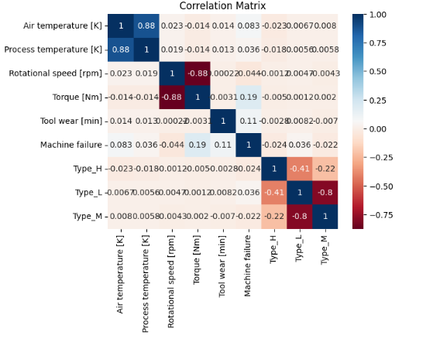
Correlation Matrix
-> The correlation matrix shows that there is a strong positive correlation between Process temperature and Air temperature .

Slide 10
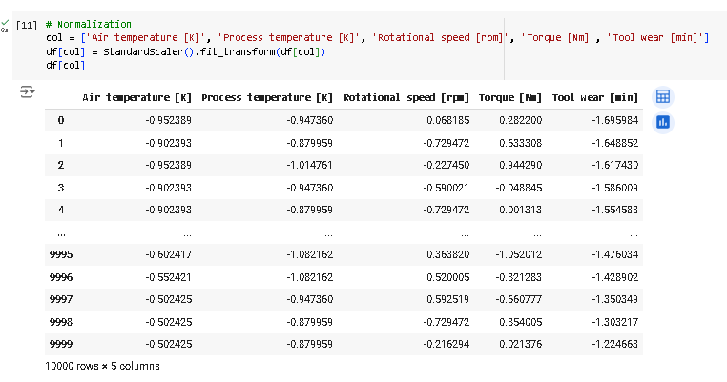
Normalization
-> The purpose of normalization is to ensure that all selected numerical features in the DataFrame have similar scales and distributions.
- By standardizing the data to have a mean of 0 and a standard deviation of 1, normalization makes it easier to compare and interpret the relative importance of different features in subsequent analyses.
- normalization can improve the performance and convergence of ML algorithms .

Slide 11
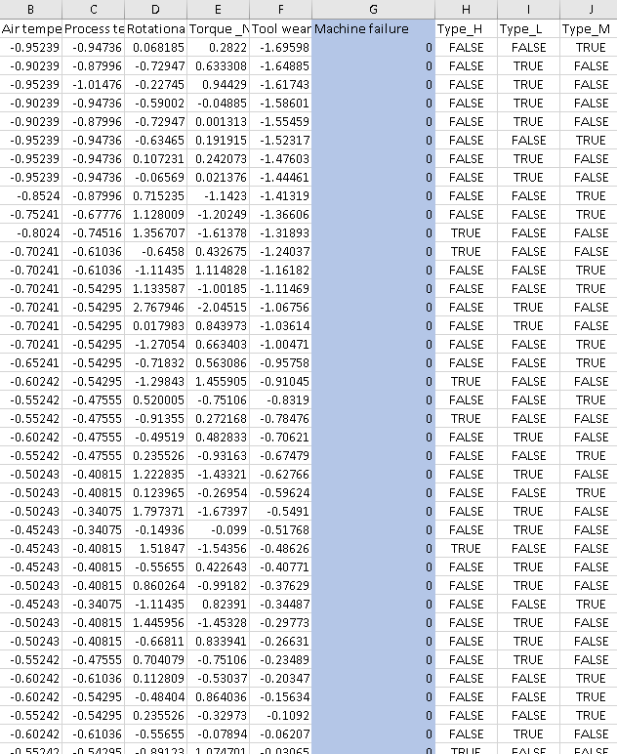
Training set , Prediction Set
After preprocessing my data , I exported it into a csv file to use it in upcoming steps .
Our target will be “ Machine Failure “ since our purpose is to predict it .
For the data to predict , I used the sama train set after dropping the Target .
train_set.csv

Slide 12
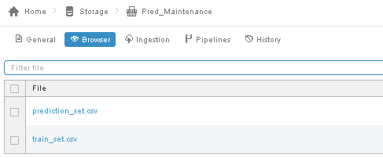
Data Storage
In Data Factory studio , Created a new bucket where I imported The two csv files : Train set and prediction set .

Slide 13

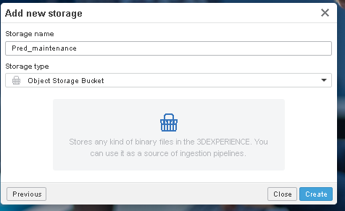
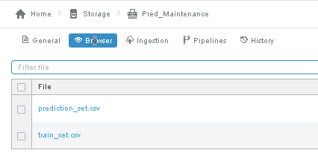
Data Storage
In Data Factory studio , Created a new bucket where I imported The two csv files : Train set and prediction set .

Slide 14

Modeling
used Machine Learning workbench for this phase to predict the machine failure . Tried two different algorithms :
Random Forest
XGBOOST

Slide 15
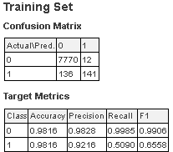
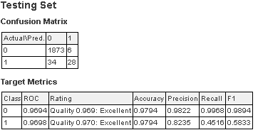
After Training my Models on the training set , here is the Report for each Model
Random Forest

Slide 16
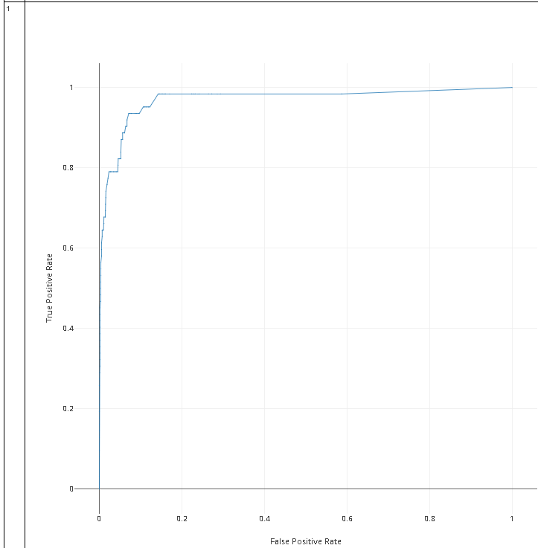
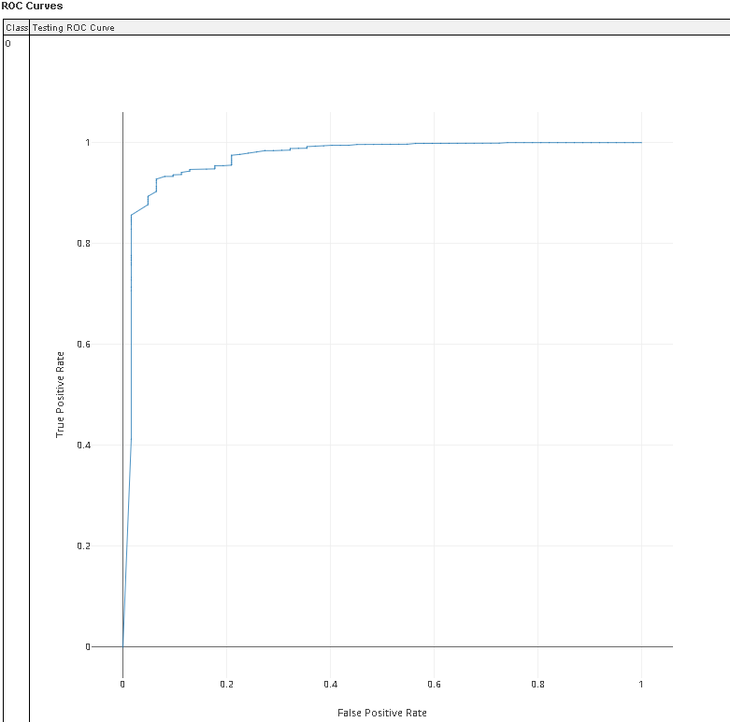

Slide 17
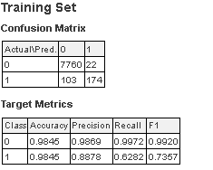
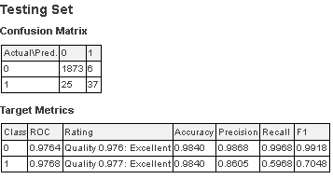
XGBOOST

Slide 18
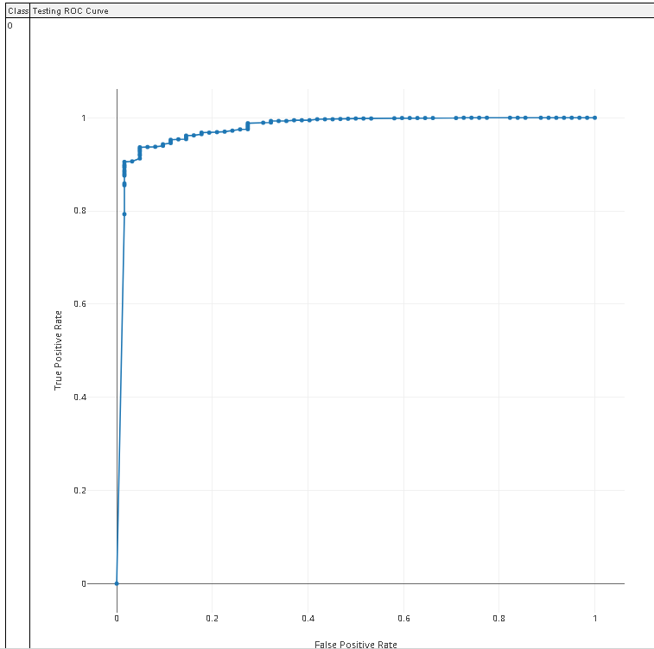
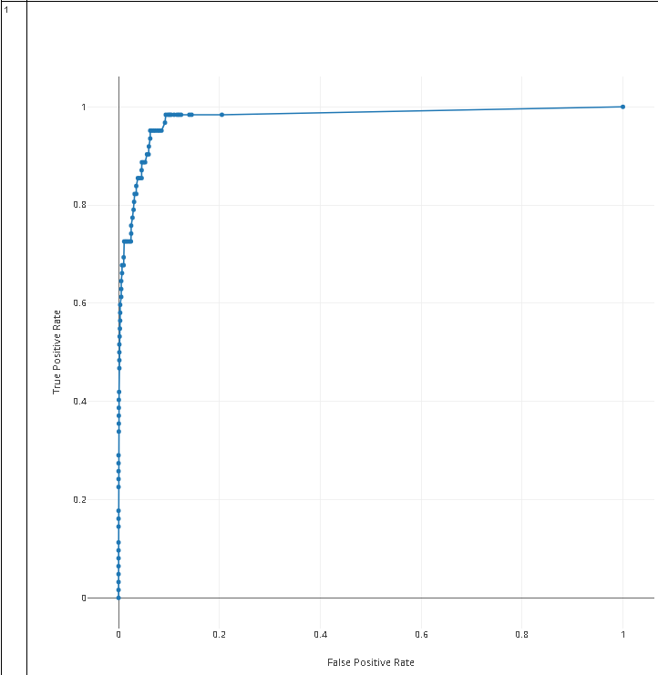

Slide 19
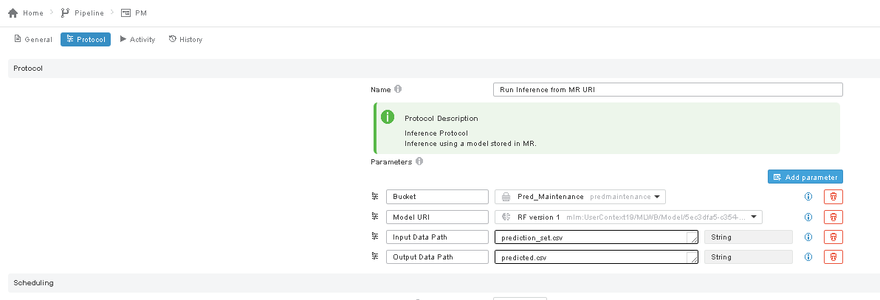
Prediction
Created a new pipeline in data factory studio

Slide 20
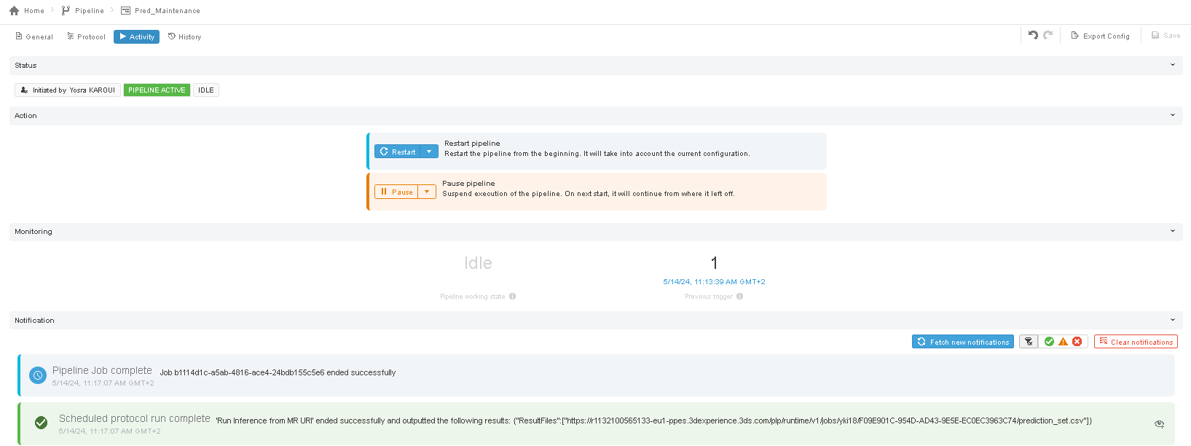
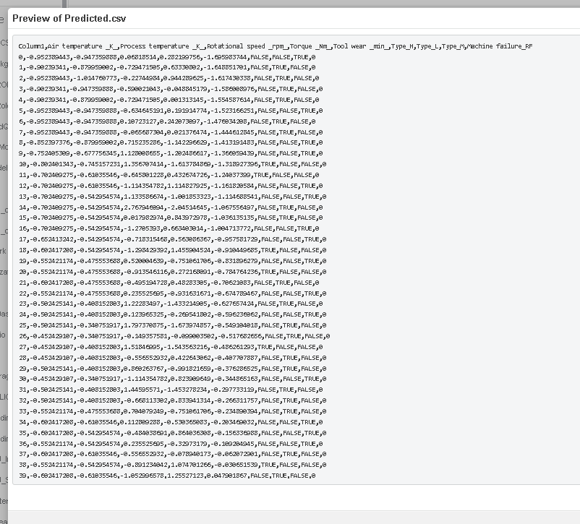
once the pipeline is idle we check our Data Bucket in data factory ; a new csv called predicted.csv is generated .

Slide 21
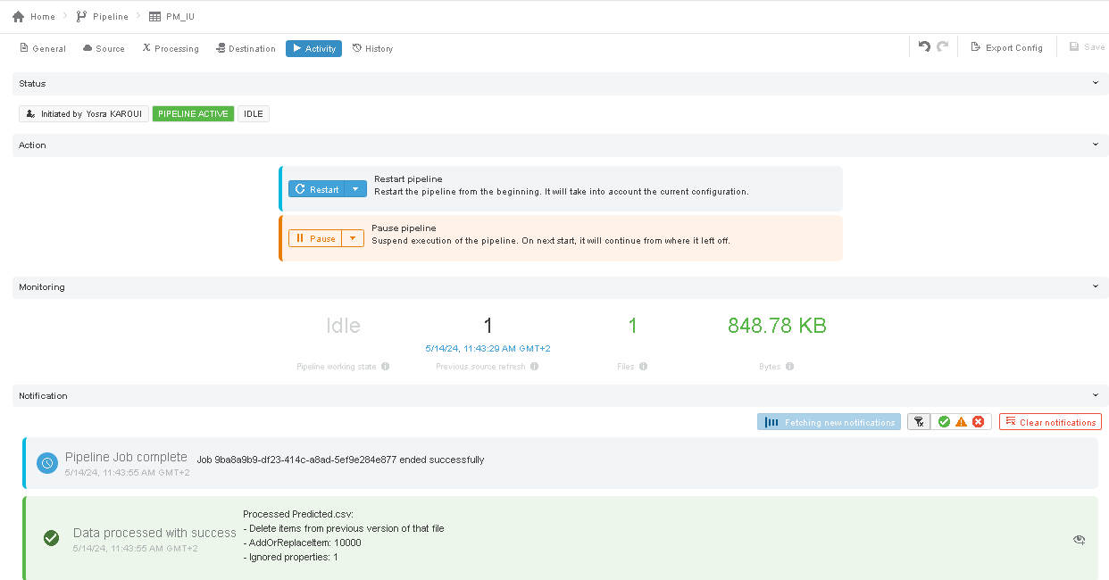
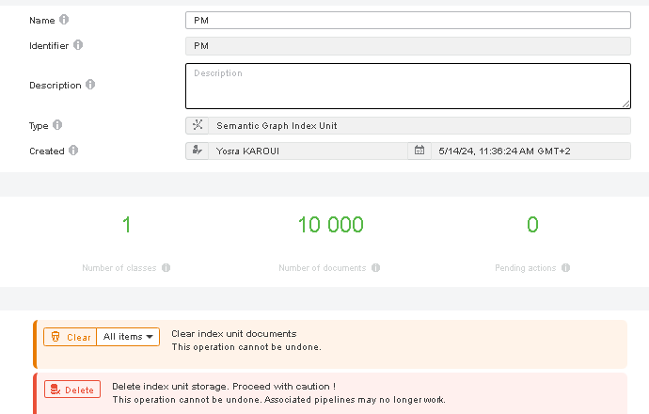
Now we need to create a new pipeline to transform the predicted.csv file into an index unit so we can use it in the next step .

Slide 22
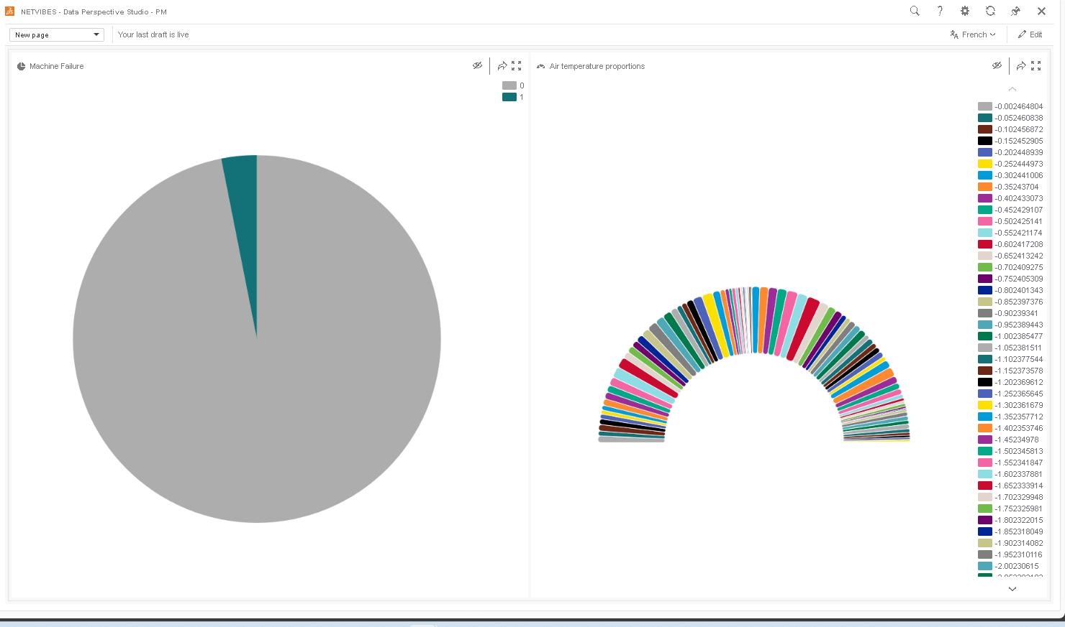
Results Visualization
Now in data perspective w create a query to visualize our result .

